Slide 1

LOVELY PROFESSIONAL UNIVERSITY,JALANDHAR
HOTEL BOOKING DASHBOARD
SUMBITTED BY:
SNEHA SINGH
11808742

Slide 2



INTRODUCTION
This project covers the analysis part of Booking Details for the year 2015-17 based on some Type of hotel. This dataset consists of various data fields like – Hotel Type,Booking year,special requirement, etc.
Analysis is done using the different tools of Microsoft Excel like – pivot table, pivot chart, slicers etc. To perform analysis on dataset to analysis of bookings yearwise,total cancelletion,special requirements etc.

Slide 3



Objectives
Analysis of the different types of hotel booked evey year.
Analysis of the Reservation Status every year.
Analysis of the Hotel Reserved every year according to different types.
Analysis of Changes occurred in Booking per year .
Analysis of Top 10 Countries Booked Hotel every year.
Analysis of Marketing Segement of different hotel.
Analysis of Total Special Requests made by Customers .
Analysis of Different Type of Customers Booked the hotel.
Analysis of Total no. of Adults,Children and babies booked hotel every year.
Analysis of Reservation In hotel Monthly.
Analysis of Channel Distribution.

Slide 4

Analysis Results

Slide 5
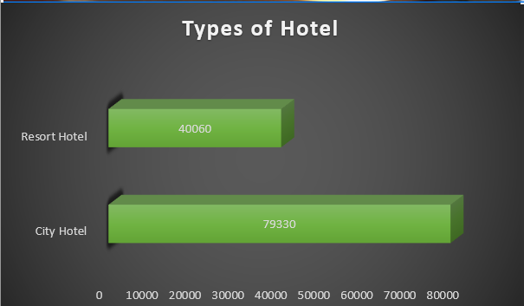
TYPES OF HOTEL
Analysis of the Total No. Of different types of hotel booked every year
Total No. Of Hotel Booked over 2015-2016
City Hotel=79330
Resort Hotel=40060

Slide 6
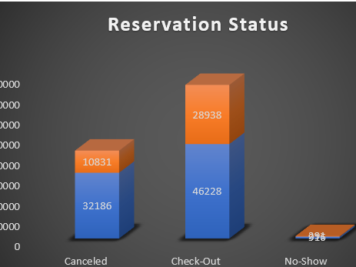
RESERVATION STATUS
Analysis of the Reservation Status every year.
Total no. of Canceled,check-out,No-show done in year 2015-2017.
City Hotel:
Canceled=32186
Check-out=46228
No-show=916
Resort Hotel:
Canceled=10831
Check-out=28938
No-show=291

Slide 7
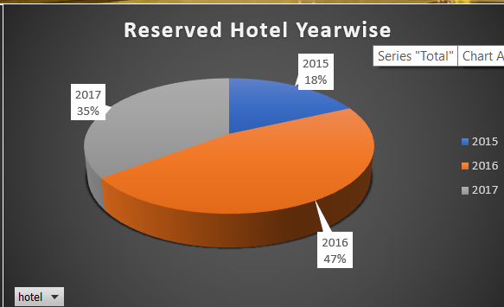
RESERVED HOTEL YEARWISE
Analysis of the Hotel Reserved every year .
2015=18%
2016=47%
2017=35%

Slide 8
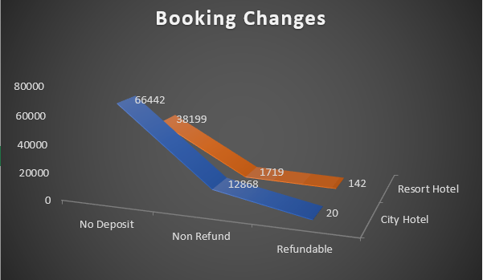
BOOKING CHANGES
Analysis of Changes occurred In Booking Every Year.
City Hotel:
No Deposite=66442
Not Refundable=12868
Refundable=20
Resort Hotel:
No Deposite=38199
Not Refundable=1719
Refundable=142

Slide 9
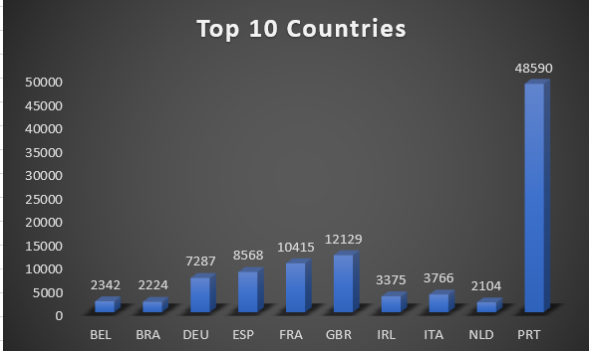
TOP 10 COUNTRIES
Analysis of Top 10 Countries Booked Hotel every year.

Slide 10


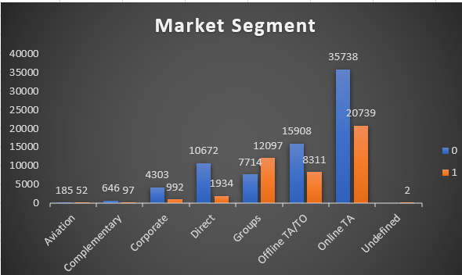
MARKETING SEGEMENT
Analysis of Marketing Segement of different hotel.

Slide 11

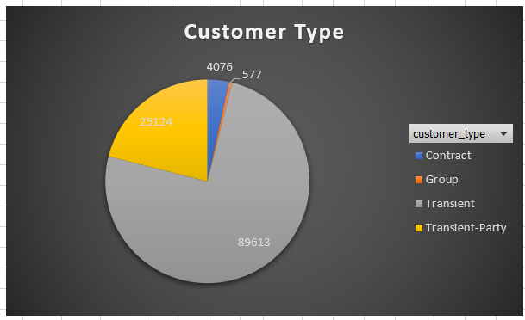

TYPE OF CUSTOMERS
Analysis of Different Type of Customers Booked the hotel.
Total No. Of Different type of Customer:
Contract Type Customer=4076
Group Type Customer=577
Transient Type Customer=89613
Transient-Party Type Customer=25124

Slide 12

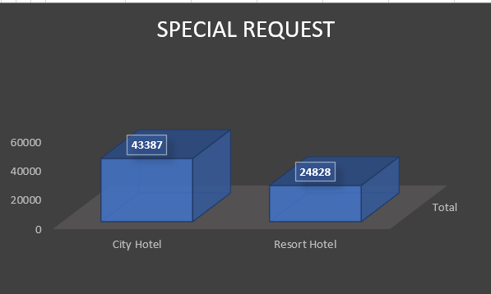
SPECIAL REQUEST
Analysis of Total Special Requests made by Customers .

Slide 13
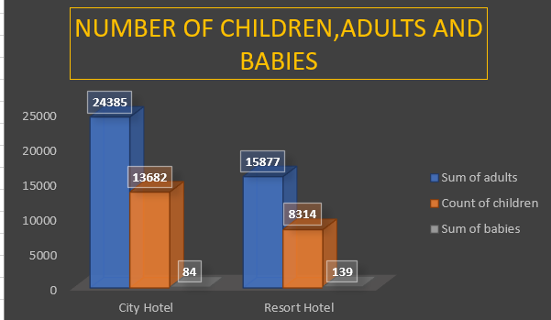
NUMBER OF CHILDREN,ADULT,BABIES
Total no. of Adults,Children,Babies in Different Hotel.i.e.
City Hotel:
Children=79330
Adult=146838
Babies=392
Resort Hotel:
Children=40060
Adult=74798
Babies=557

Slide 14
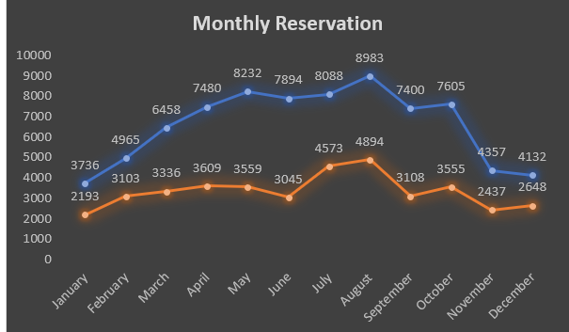
MONTHLY RESERVATION
Analysis of Reservation In hotel Monthly

Slide 15
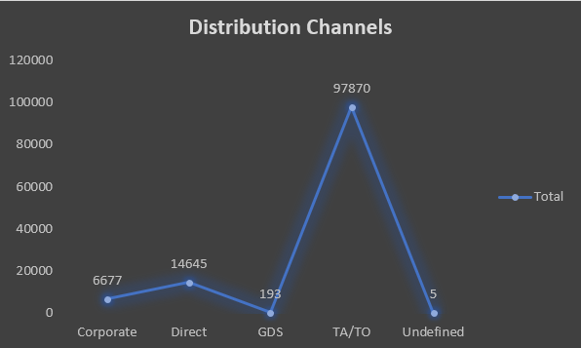
CHANNEL DISTRIBUTION
Analysis of Channel Distribution.

Slide 16

DASHBOARD

Slide 17
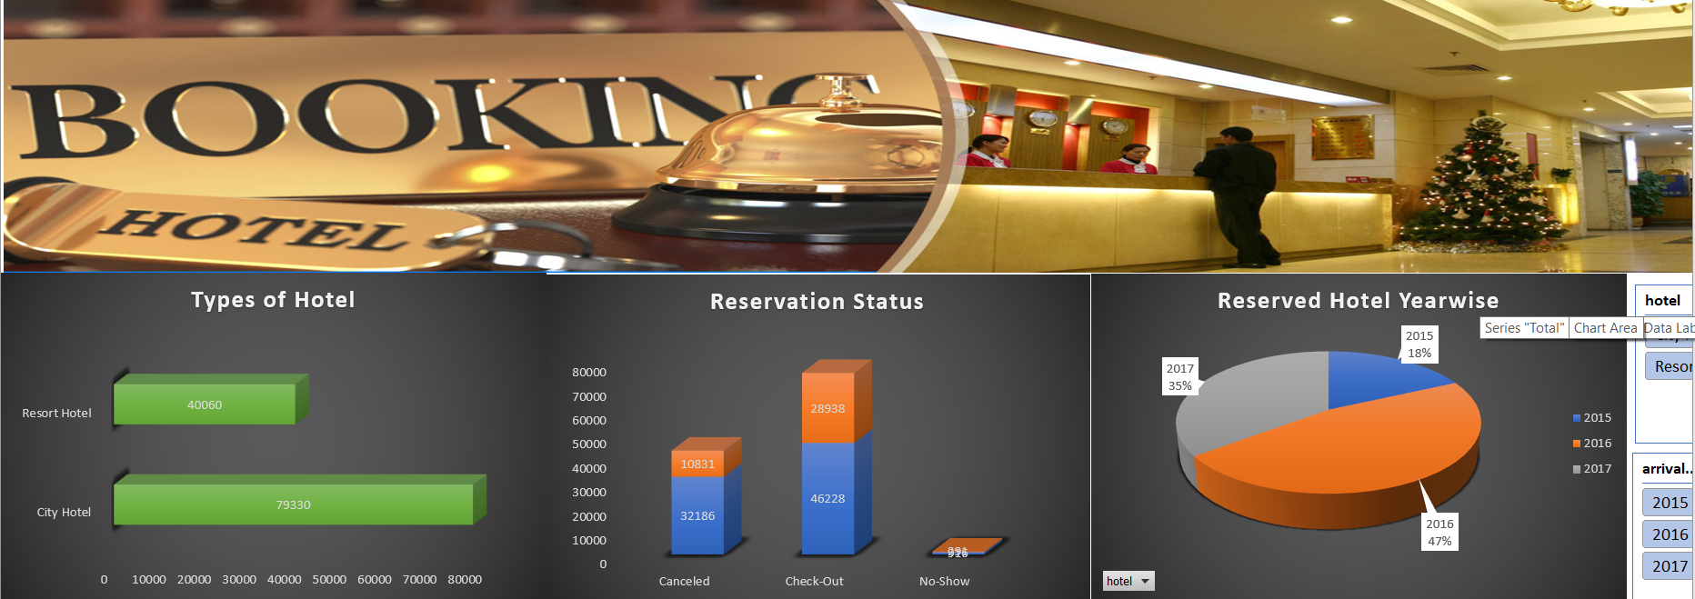
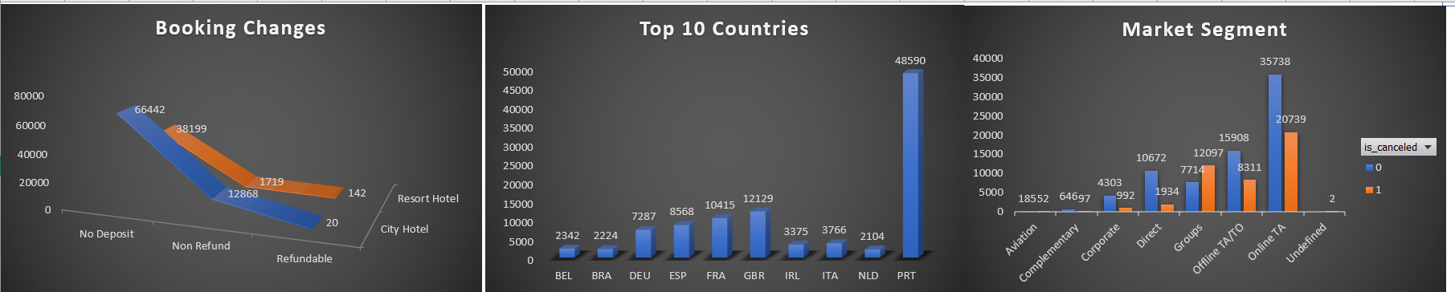
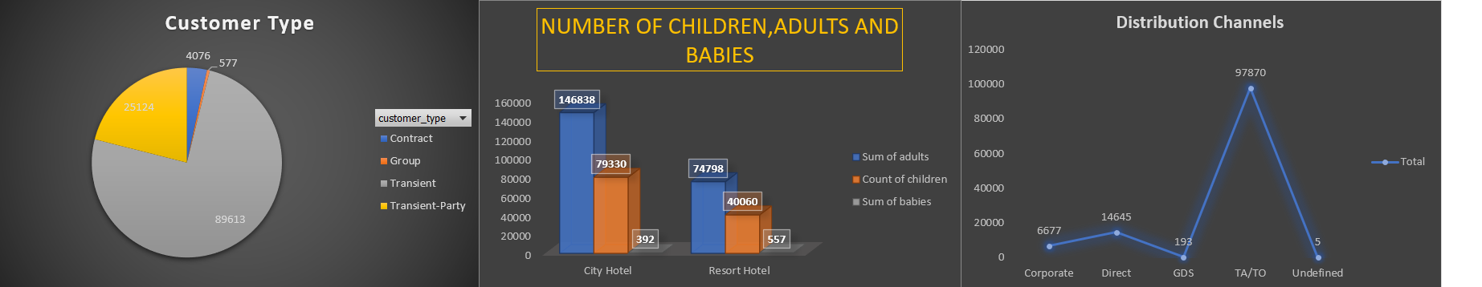
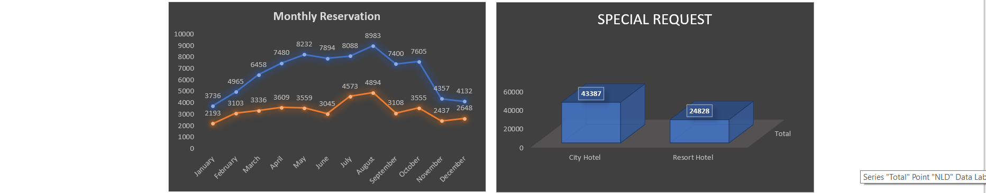

Slide 18

CONCLUSION
In conclusion, MS-Excel is a great tool for data analysis to computer science and the professionals who utilize them. Data analysis have their advantages and disadvantages like everything in our lives. Only advance users can make use of data analysis, and any problem involving data analysis will need a professional to use it. Luckily, there are more advantages than there are disadvantages. Data analysis allow information to analysis the data and retrieve useful information, it provides the means for management of large data like databases, work together and are necessary for efficient analysis, safe storage of data, allows easier processing of data, and the use of the internet to access data anytime. With those odds, this makes it easy to accept that without these kinds of applications in our lives, life would be that much harder when dealing with computer science and even our day to day tasks.

Slide 19


